Slide 1
Hotel Reservation Analysis with SQL
PROJECT BY : MARIAM OPEYEMI MOJEED
EMAIL : OPEYEMI3699@GMAIL.COM

Slide 2
OVERVIEW
The hotel industry relies on data to make informed decisions and provide a better guest experience.
In this internship, you will work with a hotel reservation dataset to gain insights into guest preferences,
booking trends, and other key factors that impact the hotel's operations. You will use SQL to query and
analyze the data, as well as answer specific questions about the dataset.

Slide 3
THE DATASET INCLUDES
Booking_ID: A unique identifier for each hotel reservation.
no_of_adults: The number of adults in the reservation.
no_of_children: The number of children in the reservation.
no_of_weekend_nights: The number of nights in the reservation that fall on weekends.
no_of_week_nights: The number of nights in the reservation that fall on weekdays.
type_of_meal_plan: The meal plan chosen by the guests.
room_type_reserved: The type of room reserved by the guests.
lead_time: The number of days between booking and arrival.
arrival_date: The date of arrival.
market_segment_type: The market segment to which the reservation belongs.
avg_price_per_room: The average price per room in the reservation.
booking_status: The status of the booking.

Slide 4
QUESTION
1.What is the total number of reservations in the dataset?
2. Which meal plan is the most popular among guests?
3. What is the average price per room for reservations involving children?
4. How many reservations were made for the year 20XX (replace XX with the desired year)?
5. What is the most commonly booked room type?
6. How many reservations fall on a weekend (no_of_weekend_nights > 0)?
7. What is the highest and lowest lead time for reservations?
8. What is the most common market segment type for reservations?
9. How many reservations have a booking status of "Confirmed"?
10. What is the total number of adults and children across all reservations?
11. What is the average number of weekend nights for reservations involving children?
12. How many reservations were made in each month of the year?
13. What is the average number of nights (both weekend and weekday) spent by guests for each room type?
14. For reservations involving children, what is the most common room type, and what is the average
price for that room type?
15. Find the market segment type that generates the highest average price per room.

Slide 5
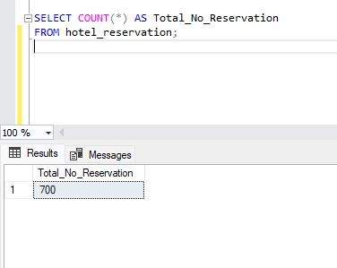
What is the total number of reservations in the dataset?
The analysis shows that the total number of reservation is 700.
Notes:
The analysis shows that the total
number of reservation is 700.

Slide 6
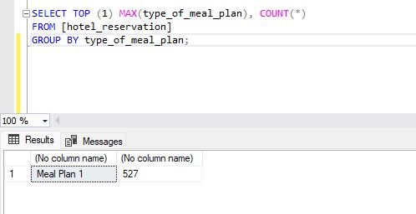
Which meal plan is the most popular among guests?
This analysis shows that mean plan 1 is the most popular mean and has a total of 527.

Slide 7
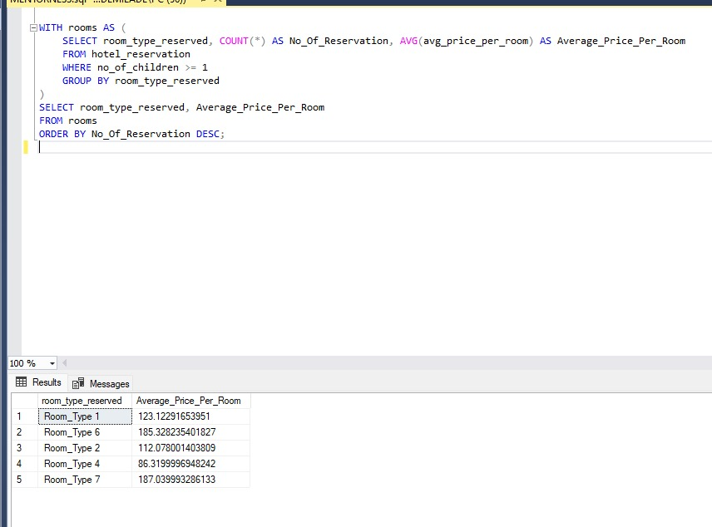
What is the average price per room for reservations involving children?

Slide 8
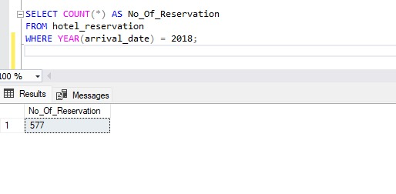
How many reservations were made for the year 20XX (replace XX with the desired year)?
This analysis shows that in year 2018 a total of 577 reservations were made.

Slide 9
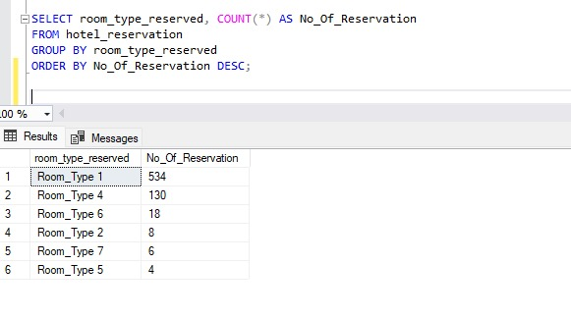
What is the most commonly booked room type?
This shows that the common room type reserved is room type 1 which contributed to 534 of the reservation.

Slide 10
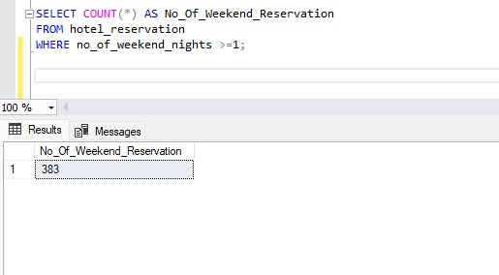
How many reservations fall on a weekend (no_of_weekend_nights > 0)?
With this, the analysis shows that the total reservation which falls on weekend is 383.

Slide 11
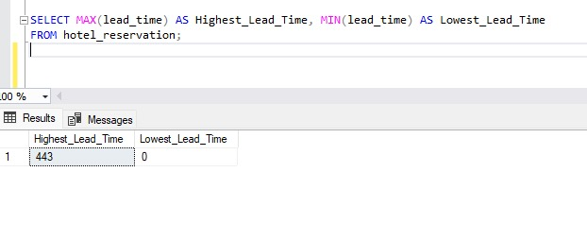
What is the highest and lowest lead time for reservations?

Slide 12
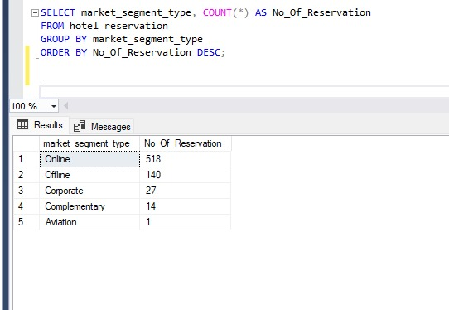
What is the most common market segment type for reservations?
The most common segment market type contributed amounted to 518 reservations.

Slide 13
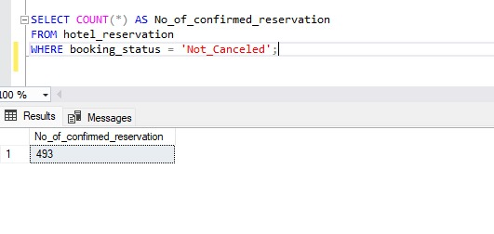
How many reservations have a booking status of "Confirmed"?
In this hotel reservation, it shows that booking status which the hotel confirms contributed to 493 reservations.

Slide 14
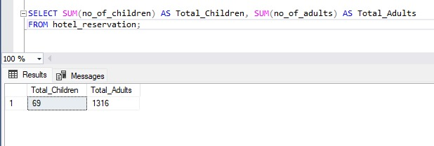
What is the total number of adults and children across all reservations?
The total number of children is 69 while Adults is 1316, which means that Adults contributed a larger amount to the reservation.

Slide 15
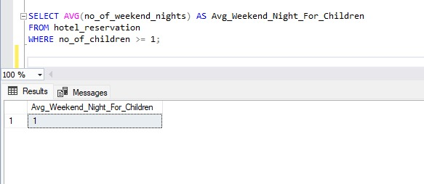
What is the average number of weekend nights for reservations involving children?

Slide 16
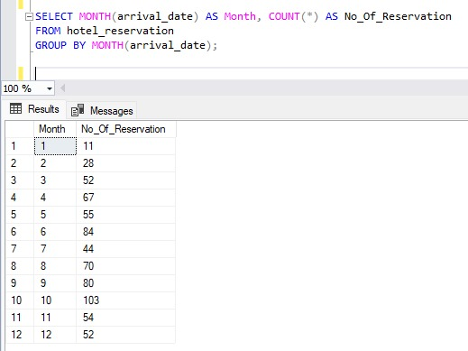
How many reservations were made in each month of the year?

Slide 17
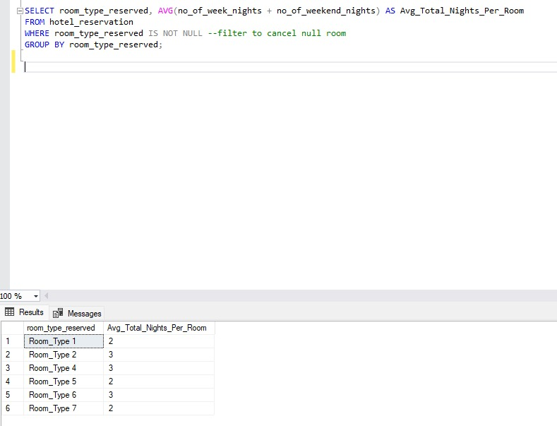
What is the average number of nights (both weekend and weekday) spent by guests for each room type?
The number of both weekend and weekday spent by guest is 2 while the room type 1.

Slide 18
For reservations involving children, what is the most common room type, and what is the average price for that room type?

Slide 19
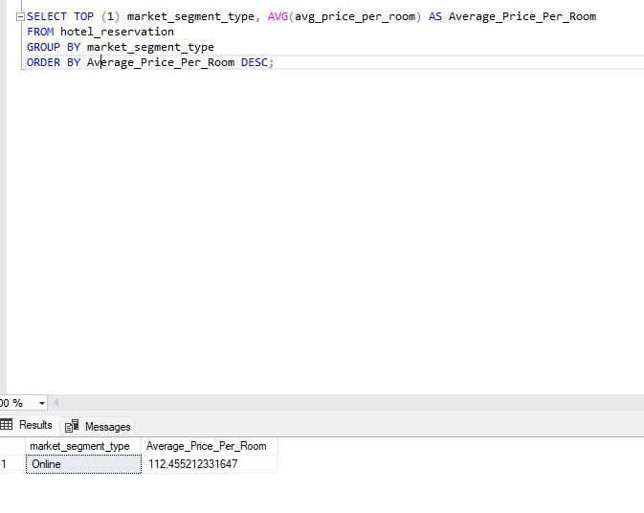
Find the market segment type that generates the highest average price per room
The market segment is Online and the average per room is 112.455 for the room type.

